Slide 1

Department of Computer Science and Engineering VIGNAN’S LARA INSTITUTE OF TECHNOLOGY AND SCIENCE
Project Review on
Customer Churn Prediction Using Machine Learning
Under The Esteemed Guidance of
Dr. V. Sujatha, Ph.D.
Professor
CSE Department
Presented By
Batch No: A15
G. Sridatta Anirudha Nivas (18FE1A0536)
Ch. Teja Venkat (18FE1A0514)
J. Hemanth (19FE5A0503)
G. Prudhvi (18FE1A0538)
22/6/22 Department of Computer Science & Engineering 1

Slide 2

CONTENTS
Title
Problem Description
Abstract
Introduction
Existing system
Proposed system
Literature survey
Software/Hardware requirements
Algorithms Implemented
Results
22/6/22 Department of Computer Science & Engineering 2

Slide 3
TITLE
Customer Churn Prediction using Machine Learning
22/6/22 Department of Computer Science & Engineering 3

Slide 4
PROBLEM DESCRIPTION
Customer churn is a major problem and one of the most important concerns for large companies. Due to the direct effect on the revenues of the companies, especially in the telecom field, companies are seeking to develop means to predict potential customer to churn.
Therefore, finding factors that increase customer churn is important to take necessary actions to reduce this churn.
22/6/22 Department of Computer Science & Engineering 4

Slide 5
ABSTRACT
The customer churn prediction is one of the challenging problems in the telecom industry. With the advancement in the field of machine learning and artificial intelligence, the possibilities to predict customer churn has increased significantly. The key to unlock solutions to this problem is by forecasting the customers which are at risk of churning The main contribution of our work is to develop a churn prediction model which assists telecom operators to predict customers who are most likely subject to churn. The proposed churn prediction model is evaluated using metrics, such as accuracy, precision, recall, fmeasure, and receiving operating characteristics (ROC) area. The results reveal that the proposed churn prediction model produced better churn classification with an accuracy of 96% using the Gradient Boosting algorithm.
22/6/22 Department of Computer Science & Engineering 5

Slide 6
INTRODUCTION
The globalization and advancements of telecommunication industry, exponentially raises the number of operators in the market that escalates the competition . In this competitive era, it has become mandatory to maximize the profits periodically, for that various strategies have been proposed, namely, acquiring new customers, up-selling the existing customers & increasing the retention period of existing customers.
Among all the strategies, retention of existing customers is least expensive as compared to others. In order to adopt the third strategy, companies have to reduce the potential customer churn . That is customer movement form the one service provider to other. The main reason of churn is the dissatisfaction of consumer service and support system.
22/6/22 Department of Computer Science & Engineering 6

Slide 7
INTRODUCTION
One of the main aim of Customer Churn prediction is to help in establishing strategies for customer retention. Along with growing competition in markets for providing services, the risk of customer churn also increases exponentially. Therefore, establishing strategies to keep track of loyal customers (non-churners) has become a necessity. The customer churn models aim to identify early churn signals and try to predict the customers that leave voluntarily.
22/6/22 Department of Computer Science & Engineering 7

Slide 8
EXISTING SYSTEM
Customer churn prediction is one of the major problem in many fields such as banking,telecom etc.
The existing systems used various kind of methodologies such as decision tree, naïve bayes etc. In most of the methods the data pre-processing is performed ,the data is divided into training and testing and classifier is applied on it.
In many models feature selection was not performed and sometimes the data was also imbalanced.
In feature selection, optimization techniques also play a vital role that improves the prediction techniques.
However the above mentioned problems can be solved in an efficient way by adopting other techniques
22/6/22 Department of Computer Science & Engineering 8

Slide 9
PROPOSED SYSTEM
The proposed system consists of 8 phases
About Dataset
The data set contains 7043 rows (customers) and 21 columns (features) and is taken from https://www.kaggle.com/datasets/blastchar/telco-customer-churn
The data set includes information about:
Customers who left within the last month – the column is named Churn
Services that each customer has signed up for – phone, multiple lines, internet, online security, online backup, device protection, tech support, and streaming TV and movies.
Customer account information – how long they’ve been a customer, contract, payment method,paperless billing, monthly charges, and total charges.
22/6/22 Department of Computer Science & Engineering 9

Slide 10
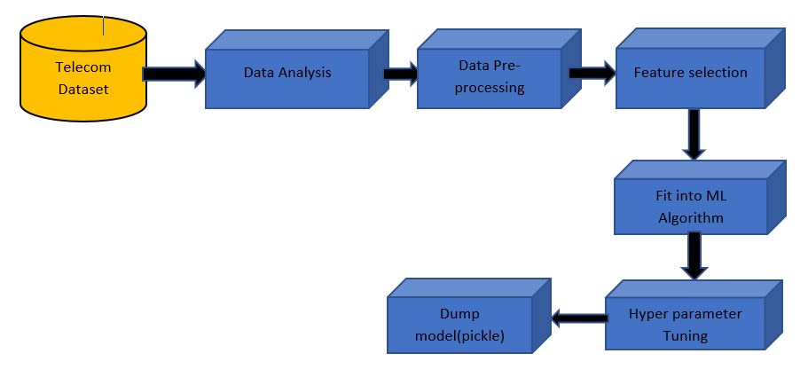
PROPOSED SYSTEM
Demographic info about customers – gender, age range, and if they need partners and dependents
Churn - dependent feature ('Yes' denotes customers left, 'No' denotes customer stay here)
Fig. Architecture of proposed model
22/6/22 Department of Computer Science & Engineering 10

Slide 11
PROPOSED SYSTEM
Data Analysis (EDA)
It is a way of exploring the hidden features that are present in the rows and columns of data by visualizing, summarizing and interpreting data.
Once EDA is done, meaningful insights are drawn that can be used for supervised and unsupervised machine learning modeling.
In our telecommunication data-set we divided the data-set into two parts: 1st Categorical features and 2nd Numerical features. From 21 features, 16 features were categorical and 5 were numerical.
Data Pre-processing
In the dataset, there are 11 missing values in the total charges column. So we replace these values with mean values.
In this dataset there are no null values, so we don't want to perform Handling missing values.
22/6/22 Department of Computer Science & Engineering 11

Slide 12
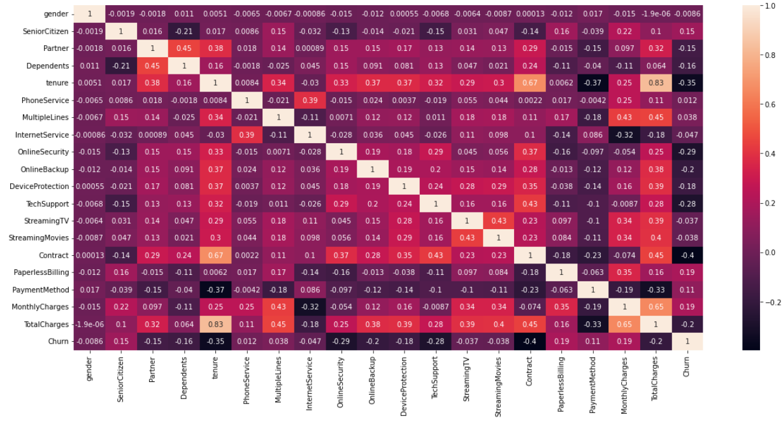
PROPOSED SYSTEM
Feature Engineering
The main aim in this step is to find the correlation and splitting dataset between the independent and dependent feature.
22/6/22 Department of Computer Science & Engineering 12

Slide 13
PROPOSED SYSTEM
Feature Selection (SelectKBest)
In our proposed system, we mainly select 10 features which have higher correlation by using feature selection methods.
From sklearn using feature selection modules importing the SelectKBest to select the important features.
According to the feature selection, we select 10 out of 21 features. These are the 10 features selected [Dependents, tenure, Online Security, Online Backup, Device Protection, Tech Support, Contract, Paperless Billing, Monthly Charges, Total charges] and we split the data into training and testing in 80-20 ratio as follows
X_train, X_test, y_train, y_test = train_test_split (X, y, test_size=0.2)
22/6/22 Department of Computer Science & Engineering 13

Slide 14
PROPOSED SYSTEM
Fit into Algorithm (ML Algorithm)
Since our data is divided into training and testing, we apply machine learning algorithms on training data.
Apart from the existing algorithms we used algorithms such as random forest, Gradient boosting classifier.
Due to imbalance dataset the results were not upto mark, so we implemented SMOTEENN methods to balance the dataset.
Hyper Parameter Tuning (RandomSearchCV)
From these results we get better accuracy using Gradient Boosting, so we performed Hyperparameter Tuning for this model only.
In our proposed model we perform HyperParameter tuning using RandomizedSearchCV method.
Dump model (Pickle)
We saved the model using pickle module and this model is able to predict the output based on the user inputs.
22/6/22 Department of Computer Science & Engineering 14

Slide 15
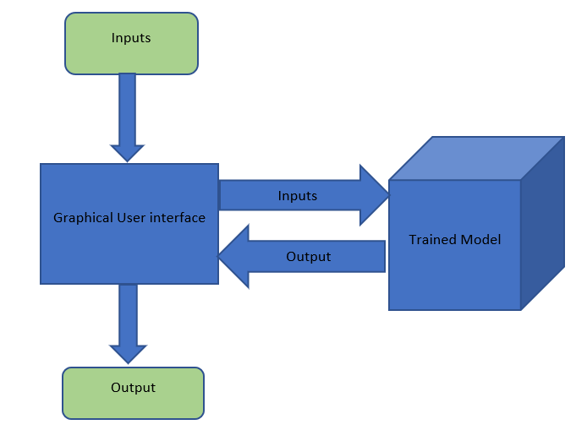
PROPOSED SYSTEM
Creating GUI using Python
We created a Graphical User Interface using tkinter module in python.
This user Interface will serve as a frontend to our model and it takes inputs from the user and predicts our desired output.
22/6/22 Department of Computer Science & Engineering 15

Slide 16
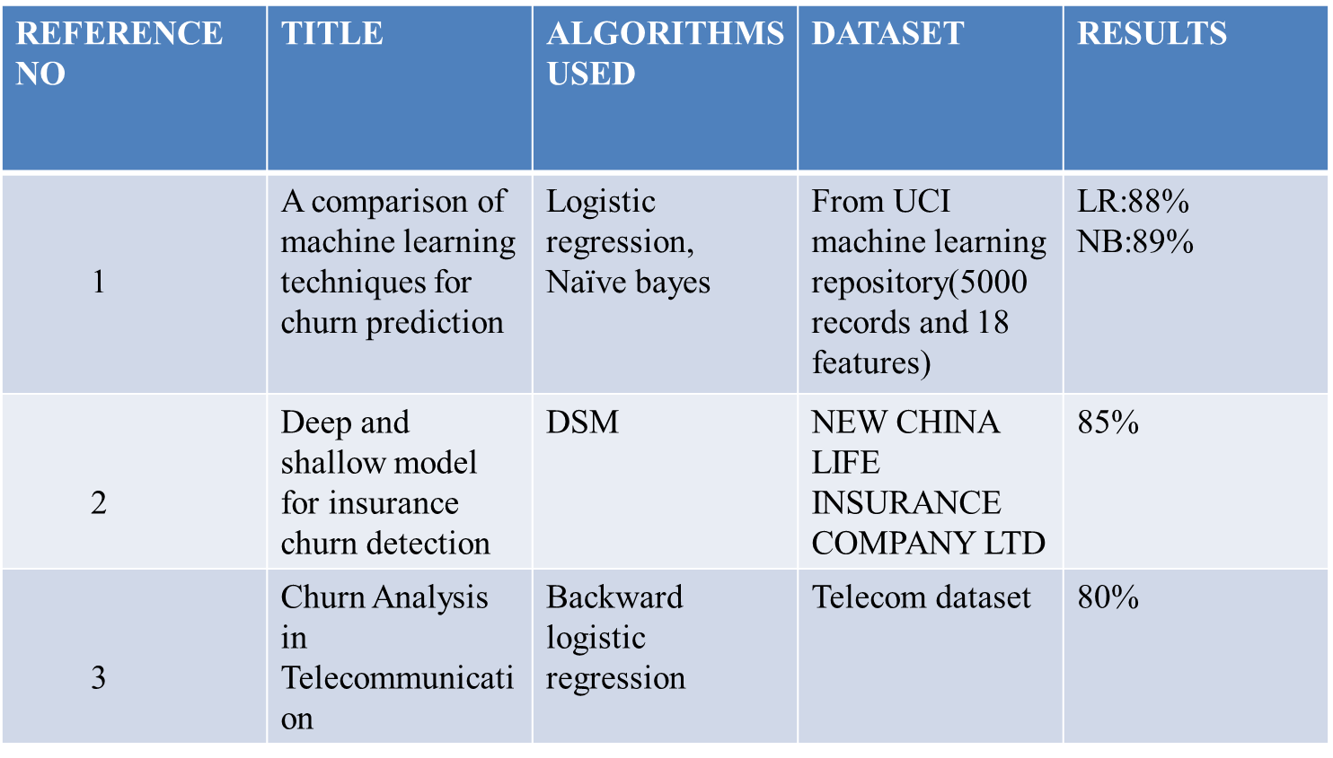
LITERATURE SURVEY
22/6/22 Department of Computer Science & Engineering 16

Slide 17
SOFTWARE/ HARDWARE REQUIREMENTS
Hardware Requirements:
CPU: Intel i5 processor with minimum of 7th generation.
RAM: Minimum of 4GB.
Operating System: Ubuntu or Microsoft Windows 9 or above.
Software Requirements:
Python
Jupyter Notebook or Google Colab.
22/6/22 Department of Computer Science & Engineering 17

Slide 18
ALGORITHMS IMPLEMENTED
The algorithms implemented in our proposed system are:
Gradient boosting classifier
SMOOTEEN methods
Gradient Boosting Classifier
Gradient boosting is a machine learning technique used in regression and classification tasks, among others. It gives a prediction model in the form of an ensemble of weak prediction models, which are typically decision trees. When a decision tree is the weak learner, the resulting algorithm is called gradient-boosted trees; it usually outperforms random forest. A gradient-boosted trees model is built in a stage-wise fashion as in other boosting methods, but it generalizes the other methods by allowing optimization of an arbitrary differentiable loss function.
22/6/22 Department of Computer Science & Engineering 18

Slide 19
ALGORITHMS IMPLEMENTED
SMOTE (Synthetic Minority Oversampling Technique) – Oversampling
SMOTE (synthetic minority oversampling technique) is one of the most commonly used oversampling methods to solve the imbalance problem.
It aims to balance class distribution by randomly increasing minority class examples by replicating them.
SMOTE synthesizes new minority instances between existing minority instances. It generates the virtual training records by linear interpolation for the minority class.
These synthetic training records are generated by randomly selecting one or more of the k-nearest neighbors for each example in the minority class.
After the oversampling process, the data is reconstructed and several classification models can be applied for the processed data.
22/6/22 Department of Computer Science & Engineering 19

Slide 20
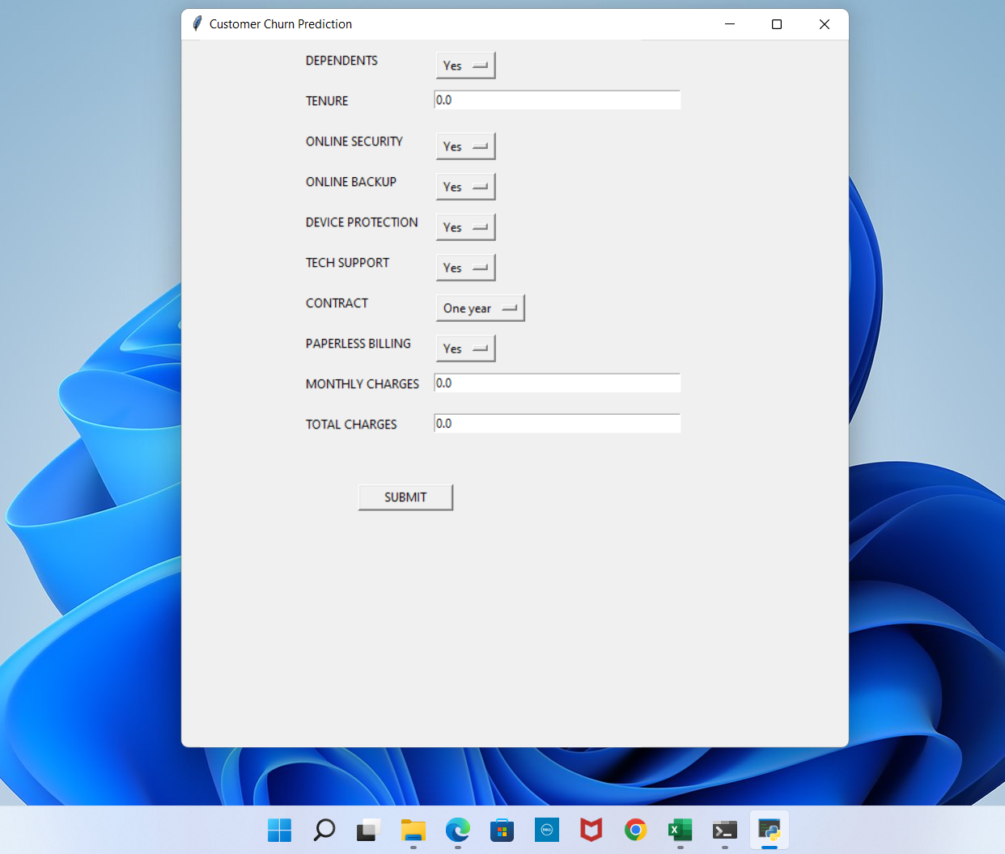
RESULTS
The output screens of our work are shown below
22/6/22 Department of Computer Science & Engineering 20

Slide 21
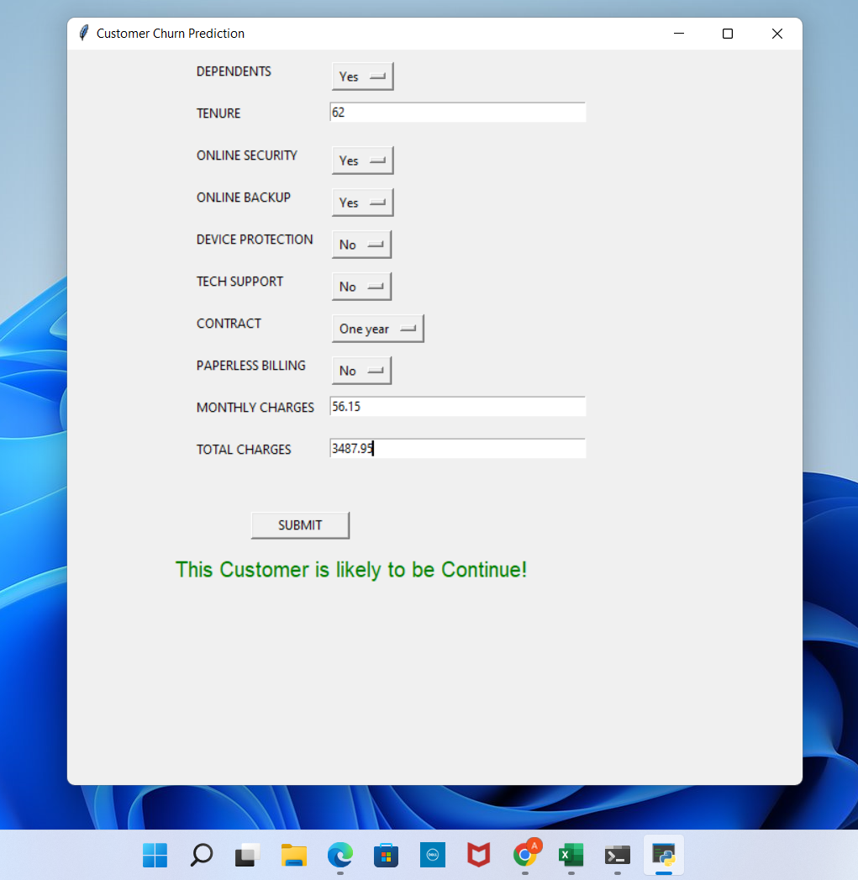
RESULTS
The above screen shows the initial GUI with some default values and it is created using the tkinter module. This UI serves as a front end for our model at the back end. In the next step ,we enter some random values as an input to the model as follows.
22/6/22 Department of Computer Science & Engineering 21

Slide 22
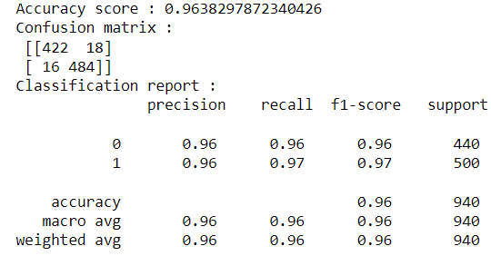
RESULTS
In the above screen for the given inputs the output is “This customer is likely to be continue!” which tells us the customer will not churn.
The model was tested with both known and unknown inputs and an accuracy of 96% was achieved for this model.
22/6/22 Department of Computer Science & Engineering 22

Slide 23
FUTURE SCOPE AND CONCLUSION
Telecommunication industry has suffered from high churn rates and immense churning loss. Although the business loss is unavoidable, churn can still be managed and kept at an acceptable level. Good methods need to be developed and existing methods have to be enhanced to prevent the telecommunication industry from facing challenges. We found that the accuracy achieved with Gradient Boosting is higher than the other techniques which clearly states that it is an efficient technique.
The future scope of this problem will use hybrid classification techniques to point out the existing association between churn prediction and customer lifetime value. The retention policies need to be considered by selecting appropriate variables from the dataset. The passive and the dynamic nature of the industry ensure that data mining has become an increasingly significant aspect in the telecommunication industry prospect.
22/6/22 Department of Computer Science & Engineering 23

Slide 24
Any queries?
22/6/22 Department of Computer Science & Engineering 24

Slide 25
Thank You
22/6/22 Department of Computer Science & Engineering 25

